Slide 1
COMMISSIONER CABINET
Monthly Training

Slide 2
Rick Bausher
Council Commissioner
Coaching &
Mentoring

Slide 3
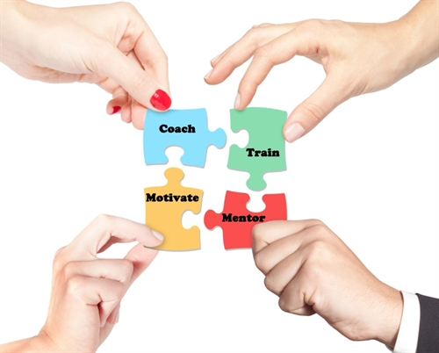
Coaching & Mentoring
What:
Basic Definitions
Notes:
COACHING is the informal support that happens through ongoing conversation and collaboration. Coaching can happen before a challenging event, in the midst of action, after a triumph or defeat, or during a pause.
MENTORING is supporting and encouraging people to manage their own learning in order that they may maximize their potential, develop their skills, improve their performance. Mentoring is an opportunity to help a person grow through discovery.

Slide 4
Coaching & Mentoring
 | Coaching | Mentoring
Goals | To correct inappropriate behavior, improve performance, and impart skills as an individual accepts a new responsibility | To support and guide the personal growth of the mentee
Initiative | The coach directs the learning and instruction. | The mentee is in charge of his or her learning.
Focus | Immediate problems and learning opportunities | Long-term personal development
Roles | Heavy on telling with appropriate feedback | Heavy on listening, providing a role model, and making suggestions and connections
Notes:
Key Differences between Coaching & Mentoring

Slide 5
Coaching & Mentoring
Who:
All “levels” of Scouting
Notes:
Coaching and Mentoring occurs at all levels of scouting!
Professional and Volunteer
Youth and Adult
Council, District & Unit

Slide 6
Coaching & Mentoring
Who:
Council Commissioner & ACC’s > District Commissioners
District Commissioners > Assistant District Commissioners > Roundtable Commissioners
Assistant District Commissioner >Unit Commissioners
Notes:
Within the Commissioner Role “coaching” is frequent – this is where the “coach” is responsible for directing and aligning the members of a team to achieve a goal.
Some examples of this coaching….

Slide 7
Coaching & Mentoring
Who:
Unit Commissioners > Unit Leaders
Unit Leaders > Youth we Serve
Notes:
Closer to the Unit Level, it is part of the basic job of Unit Commissioner to coach the leaders in the units they serve. We use the terms FRIEND, REPRESENTATIVE, DOCTOR, TEACHER, and COUNSELOR to describe the various roles of a commissioner – each of these roles require coaching skills!
Of course at the unit level, leaders are constantly coaching youth. Whether it is the SPL in the Patrol Leaders Council or new Scout in a Scoutmasters Conference – unit leaders are constantly coaching.

Slide 8
Coaching & Mentoring
Who:
Council Commissioner > Deputy Council Commissioner
District Commissioner > ADC’s
Assistant District Commissioner > Roundtable Commissioner > Unit Commissioners
Notes:
Mentoring is rewarding to both the mentor and the mentee.
Mentoring is frequently the transfer knowledge and experience (wisdom) to a new generation.
Applied to Commissioner Service, we should be “mentoring” our successors! This is sometimes called “sponsorship” mentoring.
As mentioned earlier – we should also be mentoring our Service Professionals. This would be called “developmental” mentoring.

Slide 9
Coaching & Mentoring
Why:
More effective teams; better results
Personal satisfaction
Leave a legacy!
Notes:
The benefits of coaching and mentoring are similar:
Improves knowledge and skill
Builds confidence and self esteem
Promotes individual and team excellence
Develops high commitment to common goals
Produces valuable leaders
Improves morale, motivation, and relationships
Increases volunteer retention!

Slide 10
Coaching & Mentoring
When:
Frequently – as appropriate
Regularly – agreed upon schedule
Notes:
All the time!
Examples?
Coaching – after a successful (or unsuccessful) interaction with a unit leader
Mentoring – regular monthly meetings with ADC’s or UC’s

Slide 11
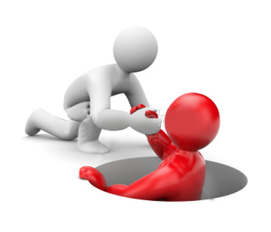
Coaching & Mentoring
How:
Key Elements of Coaching
Trusting, honest, respectful relationship
Time for preparation and reflection
Clearly defined roles, responsibilities, expectations
Effective listening skills
Strategic questions that promote thinking
Notes:
Good performance rarely happens by accident! Coaching is a consistent and reliable management style that creates an open line of communication and an opportunity for growth.
Coach early and often.
Here are some of the key elements of successful coaching:
Trusting, honest, respectful relationship
Time for preparation and reflection.
Clearly defined roles, responsibilities, expectations
Effective listening skills – EXERCISE TO FOLLOW
Strategic questions that promote thinking - EXAMPLES TO FOLLOW

Slide 12
Coaching & Mentoring
How:
Examples of Coaching Questions:
What do you hope to accomplish?
How did it go?
What happened?
What did you think?
What worked?
Why?
How do you know?
Notes:
And one of the biggest/most helpful: What would you like to do differently next time?

Slide 13
Coaching & Mentoring
How:
Key Elements of Mentoring
Goal clarity
Ability to create and manage rapport
Understanding role and boundaries
Voluntarism
Basic competencies
Proactive behaviors-mentee
Developmental behaviors-mentor
Measurement and review
Notes:
Goal clarity—There needs to be a sense of purpose to the relationship.
Ability to create and manage rapport—It is important that there is an alignment of core values between the mentor and mentee, both in terms of initial attraction or liking and in sustaining the relationship over time. However, partnering individuals with too many similarities can cause problems. The rapport-building process encompasses the skills of accepting and valuing difference as a fundamental learning resource.
Understanding of the role and its boundaries—Clarity must be maintained that thementor will not assume a directive or managerial role.
Voluntarism—Both participants have to want to be part of the relationship.
Basic competencies on the part of the mentor and mentee—Both parties must bring some skills and attributes to the table. The aim should be to improve these skills over time through the learning dialogue.
Proactive behaviors by mentee and developmental behaviors by the mentor—The mentee needs to take the initiative and the mentor must not be directive.
Measurement and review—The mentor and mentee need to take time to review the relationship. Having a regular open dialog that focuses on how to improve the relationship is a key factor. Assess how to make the relationship more valuable and reaffirm the commitment.

Slide 14
Coaching & Mentoring
How:
The Learning Conversation
Reaffirmation
Identifying the issue
Building mutual understanding
Exploring alternative solutions
Final check
Notes:
Reaffirmation—The mentor and mentee spend time to reestablish connectedness using more than just the normal social niceties. In a good relationship, there will be a mutual recognition of emotional states and the level of interest.
Identifying the issue—This is when the issue to be discussed is articulated as well as the mentee’s desired outcome is identified.
Building mutual understanding—The mentor encourages the mentee to explore the issue in depth, by asking questions that stimulate insight. The purpose of the questions is for both of them to understand the situation and all of the elements involved more clearly.
The mentor wants to avoid offering solutions or analogies to his or her own experience. When the conversation comes to a natural end, the mentor should summarize and check to see if a mutual understanding has been achieved.
Exploring alternative solutions—This is when both the mentor and mentee allow themselves to be as creative as possible, looking for ways to move forward. The goal is to build a range of solutions from which the mentee will eventually choose to take away for reflection.
Final check—The mentor encourages the mentee to review what he or she is going to do and why, and what the mentee has learned about both the situation in question and themselves. This allows for a mutual understating and places the responsibility for what happens next on the mentee.

Slide 15
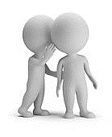
Coaching & Mentoring
Training Exercise:
Active Listening
Rate your listening skill
Series of numbers
Add them in your head
Record the total
Notes:
An important skill for both coaches and mentors is the ability to actively listen!
Refer to Active Listening sheet.

Slide 16
Coaching & Mentoring
Tools:
LHC Commissioner website: http://Commissioner-BSA.org/coach&mentor

Slide 17
Questions?

Slide 18
Notes:
Thank You

